Slide 1
Data Science
Adriano zambom

Slide 2
What is data Science?
There are several ways to define it.
Most people define data science as a collection of methods (statistical analysis), processes and algorithms (computer science) that are used to extract knowledge/information about data to to help in decision making.
The term Data Science has appeared in different areas long ago, but only in the past decade it has gained strength and become relevant. Why?

Slide 3
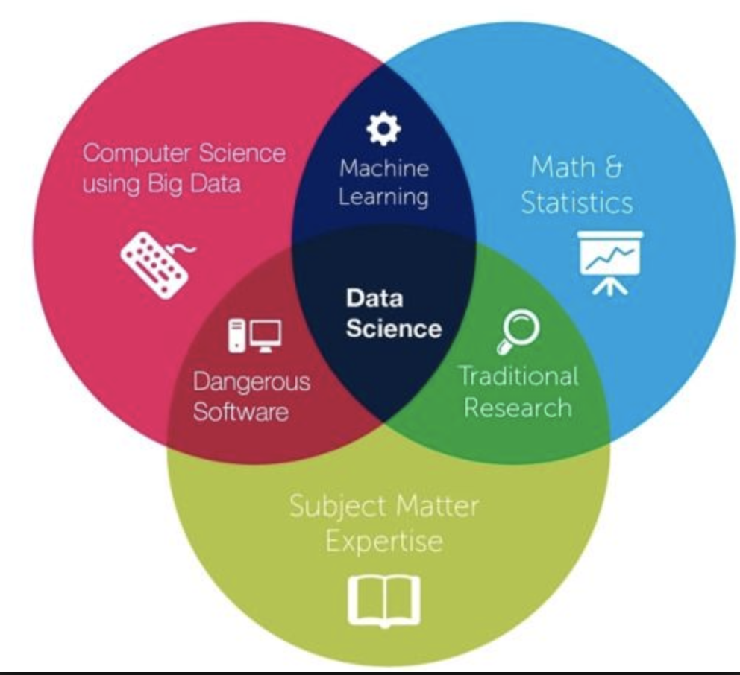
What is data Science?

Slide 4
What is data Science?
A famous statistician, John Tukey, said:
“The best thing about being a statistician is that you get to play in everyone's backyard.”
This quote is actually very much fit for data scientists.

Slide 5
What is data Science?
A data scientist has to adapt to the area he works in. For example:
Engineer may ask these questions about their data:
What can we do to optimize this process based on the current results?
How can we use past data to minimize the probability of error?
Biologist may want to know
What genes should I look at when trying to predict a disease?
Which type of fertilizer should I use to obtain the maximum growth of a specific type of plant?
HR questions about their data:
What should we do to meet or exceed the organization’s hiring and retention goals for next year?
What measures should we look for when hiring?

Slide 6
What is data science?
General guidelines for a data science program:
https://www.stat.berkeley.edu/~nolan/Papers/Data.Science.Guidelines.16.9.25.pdf

Slide 7
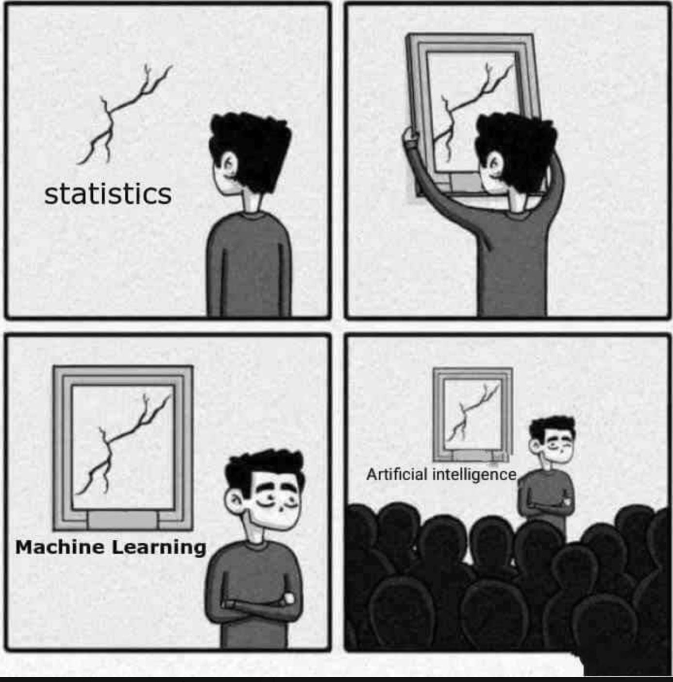
What is data science?

Slide 8
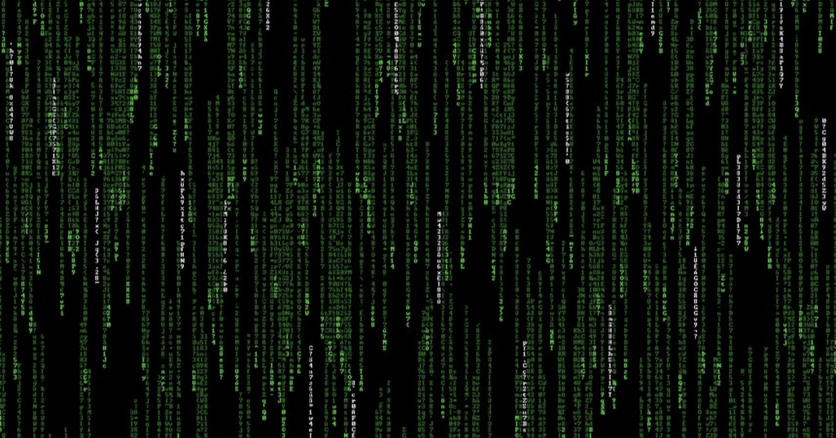
Modern world generates tons of data

Slide 9
Data is everywhere
Internet
Hospitals
Industry
Pharmaceutical
Autonomous Vehicles
Stock Market
Advertising
Biology/ Microarray
Much more

Slide 10
Ex: Autonomous vehicles
Darpa Grand Challenge – Department of Defense – 2004 – In the desert
A video
But The Darpa Grand Challenge moved to the city – Urban Challenge

Slide 11
Simplified Example of Autonomous Vehicle Data

Slide 12
Simplified Example of Autonomous Vehicle Data
Data may look like this:
time | Obstacle Car1 | Obstacle Car2 | Obstacle Car3 | Obstacle Car4
1 | (10.2, 28.7) | (-3.5, 7.2) | (39.4, 21.8) | (5.3, 0)
2 | (10.2, 28.8) | (-3.8, 7.2) | (39.4, 21.8) | (5.1, 0)
3 | (10.2, 29.9) | (-3.9, 7.2) | (39.4, 21.8) | (4.7, 0)
4 | (10.2, 30.0) | (-4.5, 7.2) | (39.4, 21.8) | (4.5, 0)
5 | (10.2, 30.1) | (-5.5, 7.2) | (39.4, 21.8) | (4.2, 0)
6 | (10.2, 30.2) | (-6.8, 7.2) | (39.4, 21.8) | (3.9, 0)
7 | (10.2, 30.3) | (-7.9, 7.2) | (39.4, 21.8) | (3.3, 0)
8 | (10.2, 30.4) | (-9.1, 7.2) | (39.4, 21.8) | (2.9, 0)
9 | (10.2, 30.5) | (-11.3, 7.2) | (39.4, 21.8) | (2.2, 0)
… | … | … | … | …

Slide 13
Simplified Example of Autonomous Vehicle Data
How to predict the next position of the obstacles?
time | Obstacle Car1 | Obstacle Car2 | Obstacle Car3 | Obstacle Car4
1 | (10.2, 28.7) | (-3.5, 7.2) | (39.4, 21.8) | (5.3, 0)
2 | (10.2, 28.8) | (-3.8, 7.2) | (39.4, 21.8) | (5.1, 0)
3 | (10.2, 29.9) | (-3.9, 7.2) | (39.4, 21.8) | (4.7, 0)
4 | (10.2, 30.0) | (-4.5, 7.2) | (39.4, 21.8) | (4.5, 0)
5 | (10.2, 30.1) | (-5.5, 7.2) | (39.4, 21.8) | (4.2, 0)
6 | (10.2, 30.2) | (-6.8, 7.2) | (39.4, 21.8) | (3.9, 0)
7 | (10.2, 30.3) | (-7.9, 7.2) | (39.4, 21.8) | (3.3, 0)
8 | (10.2, 30.4) | (-9.1, 7.2) | (39.4, 21.8) | (2.9, 0)
9 | (10.2, 30.5) | (-11.3, 7.2) | (39.4, 21.8) | (2.2, 0)
… | … | … | … | …

Slide 14
Data from LiDAR
Lidar is a detection system that works on the principle of radar, but uses light from a laser.
In autonomous vehicles it is used like this.

Slide 15
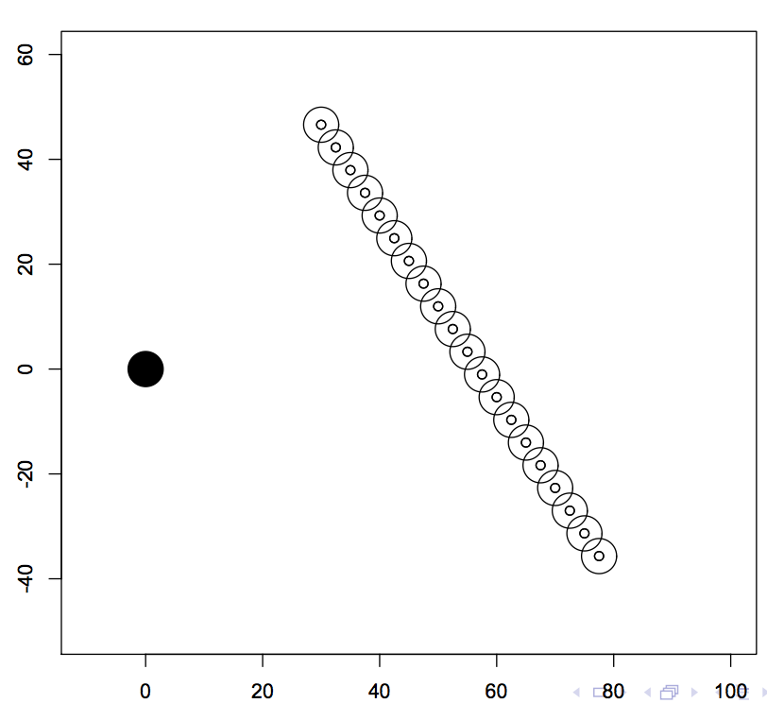
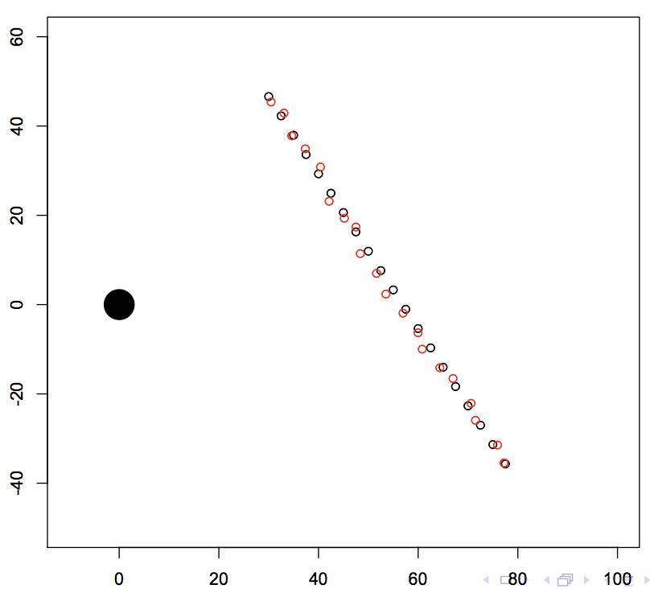
What is the data has sensor error?
Suppose this is the true locations
But we observe this: with error

Slide 16
What is the data has sensor error?
Check out this application in my webpage

Slide 17
MicroArray Data
Microarrays are very important in molecular biology
They allow monitoring the expression levels of tens of thousands of genes simultaneously
Applications include:
gene expression,
genome mapping,
SNP (single nucleotide polymorphisms) discrimination,
transcription factor activity,
toxicity,
pathogen identification and many others

Slide 18
Microarray data example – Missing data
Gene expression study on prostate cancer - Tomlins et al. (2007)
104 observations of cDNA micro-array data across 20,000 gene locations
Of these 20,000 genes, 18,106 contain at least 1 missing value and 2,570 variables are missing more than half of their observations
Genes Previously associated with Prostate Cancer: BRCA1, BRCA2 (Pritchard et al. (2016); Castro and Eeles (2012)), HOXB13 (Ewing et al. (2012); Mills (2014); Beebe-Dimmer et al. (2015); Pilie et al. (2016)), and STAT3 (Abdulghani et al. (2008); Pencik et al. (2015))

Slide 19
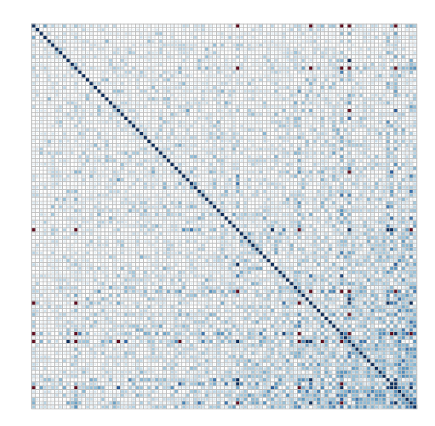
Microarray data example – Missing data
Correlation plot for some of the Genes

Slide 20
Microarray data example – Missing data
Data may look like this:
Person | Gene1 | Gene2 | Gene3 | Gene4 | Gene5 | Gene6 | Gene7 | …
1 | 23.4 | 356 | 924 | - | 36 | 45.6 | 345.7 | …
2 | 45.5 | 56 | 834 | - | 64 | 25.8 | 234.1 | …
3 | 12.2 | - | 845 | 456 | 66 | 82.8 | 833.4 | …
4 | 63.1 | 325 | 683 | 477 | 64 | - | - | …
5 | 19.9 | 54 | - | 966 | 23 | 28.34 | 126.7 | …
… | … | … | … | … | … | … | … | …

Slide 21
microArray data
What is the role of a data scientist here?
Hypothesis testing:
Compare arrays
Are differences significant?
What are your criteria for statistical significance?
Clustering: Can we find patterns in the data? Groups of genes?
Classification: Do the expression of genes predict well a disease?

Slide 22
microArray data
Two main repositories:
Gene expression omnibus (GEO) at NCBI
ArrayExpress at the European Bioinformatics Institute (EBI)

Slide 23
Facebook ads
How does Facebook decide which ads to show?
Information you share on Facebook (example: posts or comments you make) and your activity on Facebook (such as liking a Page or a post, clicking on ads you see).
Other information about you from your Facebook account (example: your age, your gender, your location, the devices you use to access Facebook).
Information advertisers and our marketing partners share with us that they already have, like your email address.
Your activity on websites and apps off of Facebook.
Extracted from: https://www.facebook.com/help/562973647153813/

Slide 24
Facebook ads
A simples dataset of activity may look like:
Date | Time | Action | Target | Object Type | Object Info
6/10/2018 | 8:37pm | View Pic | Peter | Pic | Nature
6/11/2018 | 8:10pm | Watch Vid | Maria | Video | Music
6/11/2018 | 8:24pm | Liked | Anthony | Comment | Key words: Democrat, vote
6/11/2018 | 8:35pm | Liked | Peter | Comment | World Cup
6/12/2018 | 8:01pm | View Pic | John | Pic | Nature
6/13/2018 | 8:56pm | Loved | Peter | Pic | -
6/13/2018 | 8:59pm | Comment | Barbara | Post | Key words: Democrat, campaign
6/13/2018 | 9:17pm | Post | All | Pic | Family (face recognition)
… | … | … | … | … | …

Slide 25
Facebook ads
But another dataset with your personal info exists:
Location
Age
Gender
Ethnicity
Nationalty
…

Slide 26
Facebook ads
Match person’s data to advertisement requirements/requests/target
Classification: Which personality types are most likely to buy specific types of products
Optimize revenue
History of number of clicks – with info on links to the clicked objects

Slide 27
Dating websites and Apps
Sites such as
Match.com
eHarmony
OkCupid
Tinder
Note how you can register using your Facebook profile
Use data science to match profiles based on their data
Compatibility matching models – identify potential matches based on a client's core compatibility: common personality/psychology characteristics - user profile. Example: age, distance, religion, ethnicity, income, or education, etc.
Affinity matching models – predict the probability of interaction and good communication between two people based on their profile.

Slide 28
Dating websites and Apps
Examples of anonymous personality data can be found here
Can we match users?

Slide 29
Predicting Bodyfat example
From website: http://lib.stat.cmu.edu/datasets/bodyfat
Percentage of body fat determined by underwater weighing and various body circumference measurements for 252 men
Use Multiple regression
Accurate measurement of body fat is inconvenient/costly and it is desirable to have easy methods of estimating body fat that are not inconvenient/costly.

Slide 30
Predicting Bodyfat example
D = Body Density (gm/cm^3)
A = proportion of lean body tissue
B = proportion of fat tissue (A+B=1)
a = density of lean body tissue (gm/cm^3)
b = density of fat tissue (gm/cm^3)
D = 1/[(A/a) + (B/b)]
solving for B we find
B = (1/D)*[ab/(a-b)] - [b/(a-b)] Siri’s equation: Percentage of Body Fat = 495/D - 450.

Slide 31
Predicting Bodyfat example
But our data is composed of:
Density determined from underwater weighing
Percent body fat from Siri's (1956) equation
Age (years)
Weight (lbs)
Height (inches)
Neck circumference (cm) Chest circumference (cm) Abdomen circumference (cm) Hip circumference (cm) Thigh circumference (cm) Knee circumference (cm) Ankle circumference (cm) Biceps (extended) circumference (cm) Forearm circumference (cm) Wrist circumference (cm)

Slide 32
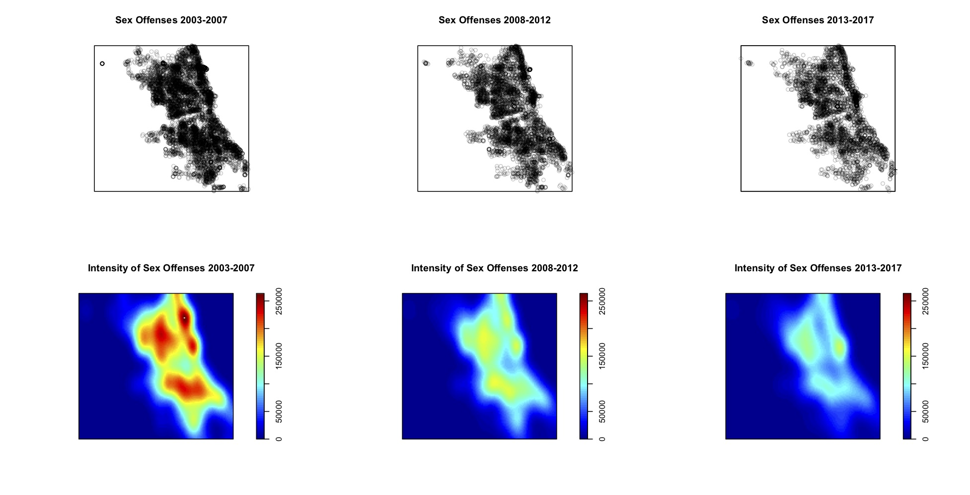
Crime in Chicago

Slide 33
Crime in Chicago
Given the past years of observed data, can you predict how many crimes will occur in Chicago?
What data would you need?
Where can we find this kind of data? Here for Chicago

Slide 34
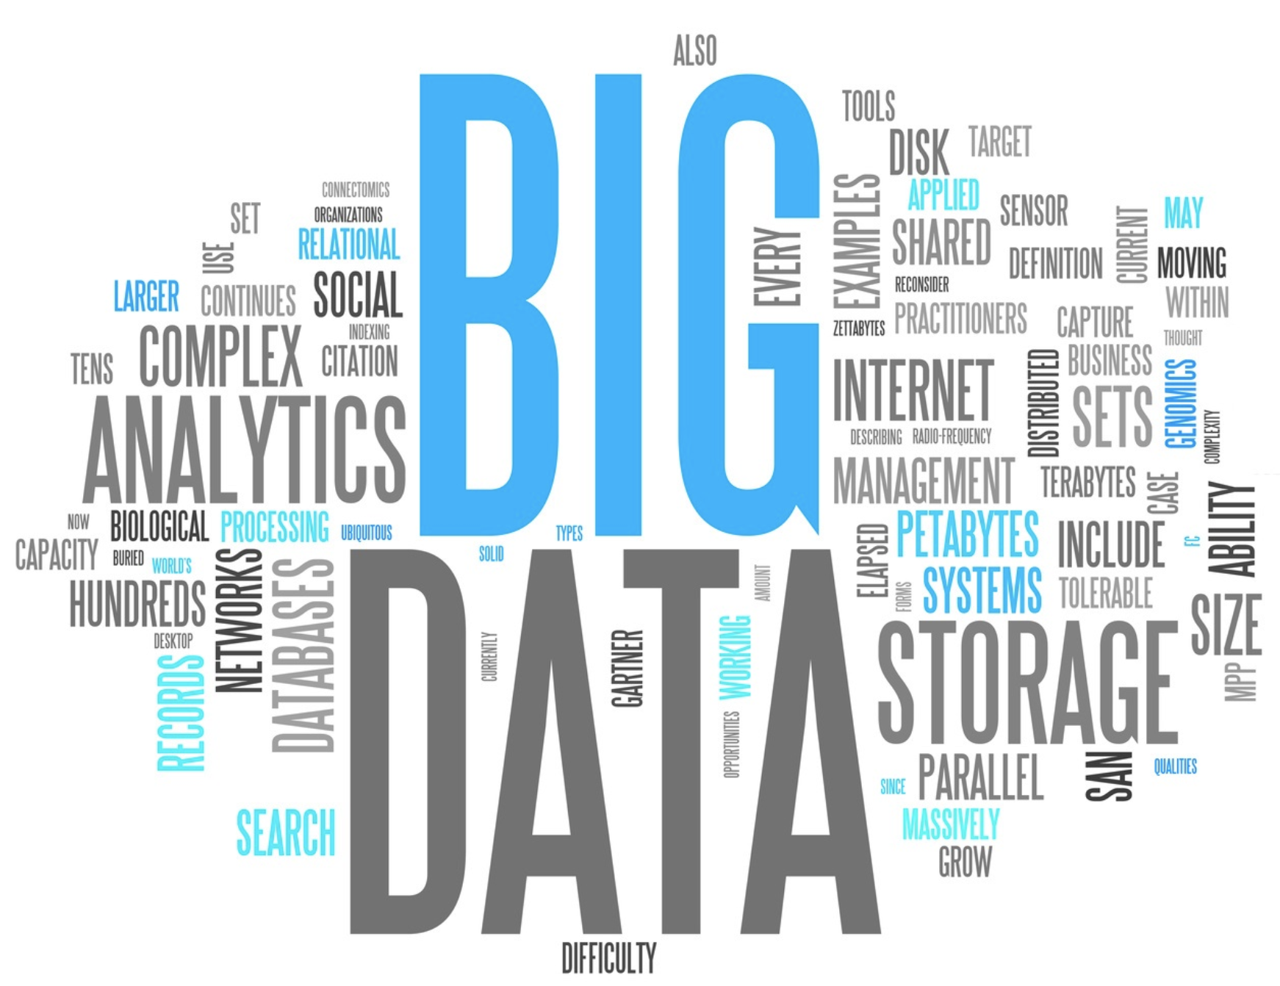

Slide 35
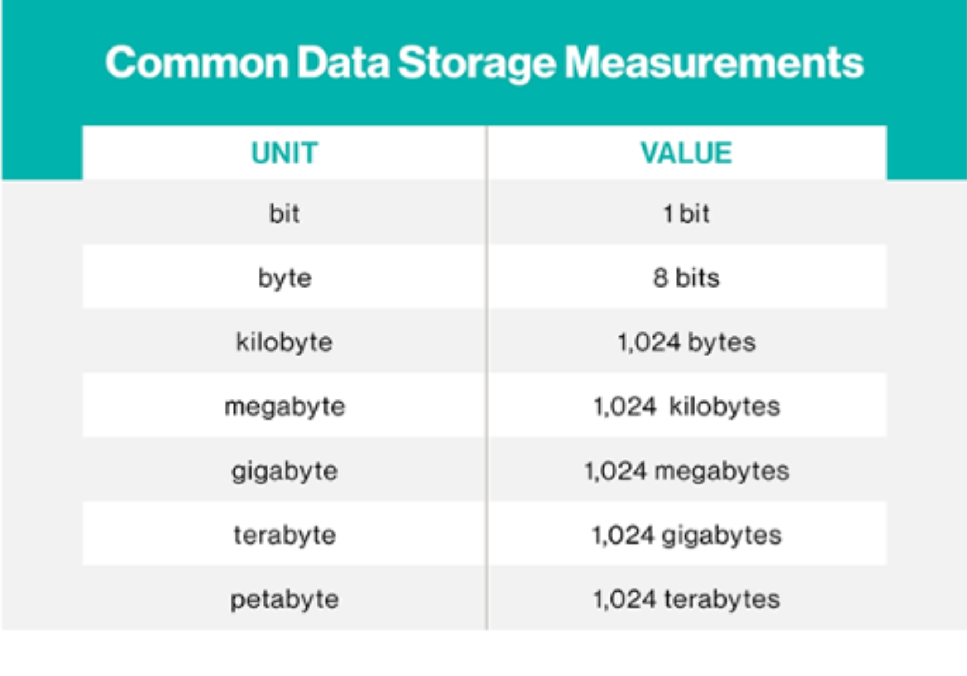
What is Big Data?
This term is usually used to describe datasets whose sizes are beyond the ability of current software/hardware to process in a reasonable amount of time.

Slide 36
What is big data?
Sometimes big data is used to refer to predictive analytics, or user behavior analytics.
In fact, the challenge is to use computer science tools to appropriately store, query, sample, transfer, and then use statistics to analyze the data.
Correctly applying these concepts, one can obtain useful information to make decisions on his business
Careful: Misuse of computer science and statistics may lead to biased conclusions!
Ex: Spurious correlations

Slide 37
Statistics as the Key
Data Science and Statistics

